Slide 1
THE NERVOUS SYSTEM
KIRAN AKBAR KHAN

Slide 2
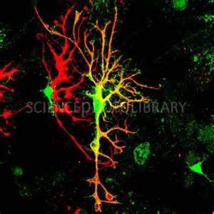
The Nervous System
A physically connected network of cells, tissues and organs that allow us to communicate with and react to the environment and perform life activities.

Slide 3
Functions of Nervous System
1. Sensory input – gathering information
To monitor changes occurring inside and outside the body (changes = stimuli)
2. Integration –
To process and interpret sensory input and decide if action is needed.
3. Motor output
A response to integrated stimuli
The response activates muscles or glands

Slide 4
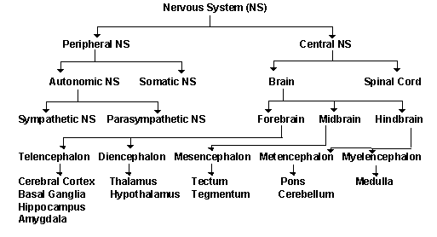
Major Divisions of Nervous System

Slide 5
Peripheral Nervous System
Consists of nerves and associated cells that are not part of the brain or spinal cord.
Receives information from the environment and relays commands from the CNS to organs and glands.

Slide 6
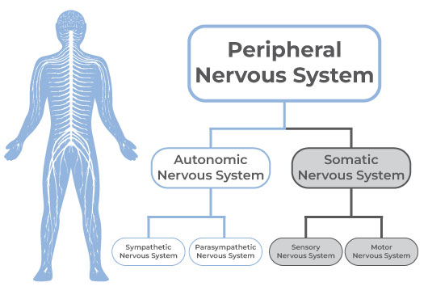
Major Division

Slide 7
Somatic Nervous System
The somatic nervous system is made up of nerves that connect to voluntary skeletal muscles and to sensory receptors.
These nerves are the cables that carry information from receptors in the skin, muscles and joints to the central nervous system and that carry commands from the central nervous system to the muscles.

Slide 8
Sensory/Afferent
They carry information inward to the central nervous system from the periphery of the body.
The sensory neurons allow us to take in sensory information and send it to the brain and spinal cord.
Motor/Efferent:
They carry information outward from the central nervous system to the periphery of the body.
These motor neurons allow us to take physical action in response to stimuli in the environment.

Slide 9
Autonomic Nervous System
The autonomic nervous system is a component of the peripheral nervous system that regulates involuntary physiologic processes including heart rate, blood pressure, respiration, digestion, and sexual arousal.
It contains two anatomically distinct divisions: sympathetic and parasympathetic.

Slide 10
Sympathetic Division
Prepares the body for stressful or emergency situations—fight or flight.
Thus, the sympathetic division increases heart rate and the force of heart contractions and widens (dilates) the airways to make breathing easier.
It causes the body to release stored energy. Muscular strength is increased. This division also causes palms to sweat, pupils to dilate, and hair to stand on end.
It slows body processes that are less important in emergencies, such as digestion and urination.

Slide 11
Parasympathetic Division
Controls body process during ordinary situations.
Generally, the parasympathetic division conserves and restores. It slows the heart rate and decreases blood pressure.
It stimulates the digestive tract to process food and eliminate wastes.

Slide 12
Central Nervous System
The central nervous system (CNS) is comprised of the brain and spinal cord. The three broad functions of the CNS are to take in sensory information, process information, and send out motor signals.
The CNS receives sensory information from the nervous system and controls the body's responses. The central nervous system plays a primary role in receiving information from various areas of the body and then coordinating this activity to produce the body's responses.

Slide 13
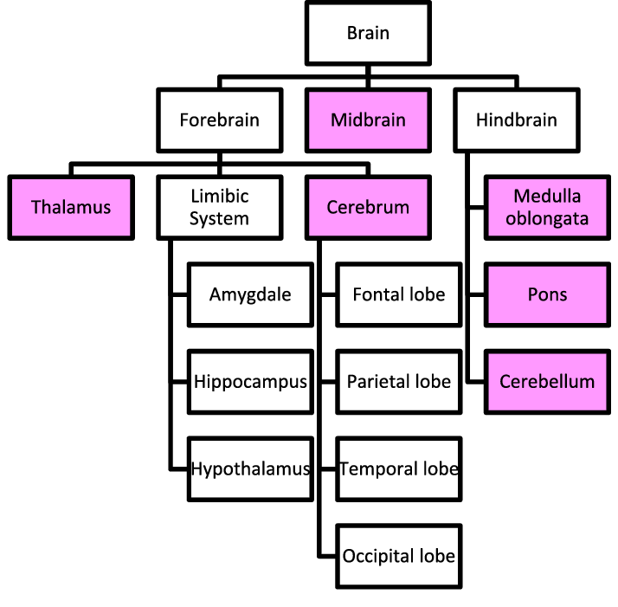
The Brain

Slide 14
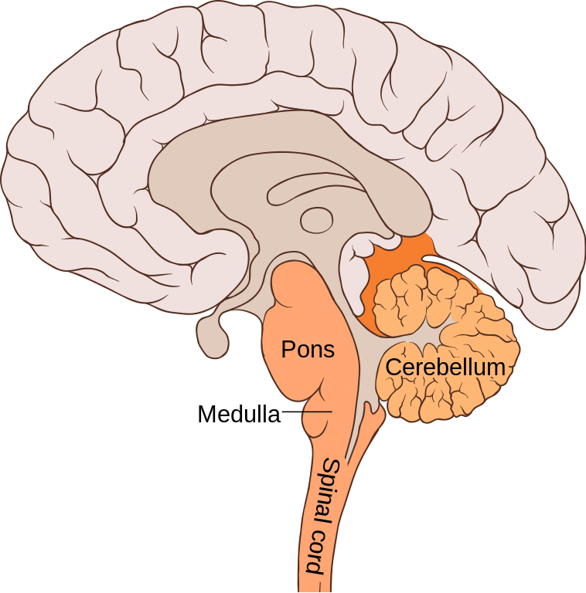
Hind Brain
Hind brain consists of three parts-cerebellum, pons and medulla oblongata.

Slide 15
Pons
The pons is a bridge in the hindbrain.
Containing large bundles of nerves, the pons acts as a transmitter of motor information, coordinating muscles and integrating movement between the right and left halves of the body.
It is also involved in regulating sleep.

Slide 16
Cerebellum
It extends from the rear end of the hindbrain.
Without the help of the cerebellum we would be unable to walk a straight line without staggering and lurching forward, for it is the job of the cerebellum to control bodily balance.
It constantly monitors feedback from the muscles to coordinate their placement, movement, and tension.
It is also involved in several intellectual functions, ranging from the analysis and coordination of sensory information to problem solving.

Slide 17
Medulla Oblongata
The medulla controls a number of critical body functions, the most important of which are breathing and heartbeat.

Slide 18
Mid brain
Relatively small in size and it connects the hindbrain with forebrain.
It consists of the reticular activating system (RAS), which is responsible for general arousal of our body.
If, e.g; we are startled by a loud noise, the reticular formation can prompt a heightened state of awareness to determine whether a response is necessary.

Slide 19
Forebrain
Considered to be the most important part of the brain because it performs all cognitive, emotional and motor activities.

Slide 20
Hypothalamus
One of the smallest structure in the brain, but plays a vital role in our behavior.
It regulates physiological process involved in emotional and motivational behavior. For example, in cases of fear, individuals may experience quickened heart rate and shallow breathing.
It regulated & control the internal environment of the body & regulates the secretion of hormones from various endocrine glands.
The hypothalamus helps manage your body temperature, hunger and thirst, mood, sex drive, blood pressure and sleep.

Slide 21
Thalamus
Consists of an egg-shaped cluster of neurons situated on the upper side of hypothalamus.
It’s like a relay station that receives all incoming sensory signals from sense organs & sends them to appropriate parts of cortex for processing.

Slide 22
Limbic system
Helps in maintaining internal homeostatic by regulating body temperature, blood pressure, and blood sugar level.
It also consists of ‘Hippocampus’ & ‘Amygdala’.
Hippocampus plays a major role in the memory processing.
Amygdala may play a central role in the learning of fear responses and the processing of other basic emotional responses.

Slide 23
Cerebrum (Cerebral Cortex)
Largest & most complex part of the human brain.
Regulates all higher cognitive functions, such as attention, perception, learning, memory, language, behavior, reasoning and problem solving.

Slide 24
2 Halves of Cerebrum
Left Hemisphere: Controls language behavior
Right Hemisphere: Deals with images, spatial relationships & pattern recognition.
Corpus Callosum: Major structure that connects the two cerebral hemispheres.

Slide 25
4-Lobes
1) Frontal Lobe: Concerned with cognitive functions.
2) Parietal Lobe: Concerned with cutaneous sensations.
3) Temporal Lobe: Concerned with processing of auditory information
4) Occipital Lobe: Concerned with visual information.

Slide 26
Studying The Brain
Brain-scanning techniques provide a window into the living brain. Using theses techniques, investigators can take a ‘snapshot’ of the internal workings of the brain without having to cut open the person’s skull.
The most important scanning techniques are the following:

Slide 27
Electroencephalogram (EEG)
It records electrical activity in the brain through electrodes placed on the outside of the skull.
Although, traditionally the EEG could produce only a graph of electrical wave patterns, new techniques are now used to transform the brain’s electrical activity into a pictorial representation of the brain that allows more precise diagnosis of disorders such as epilepsy and learning disabilities.

Slide 28
Functional Magnetic Resonance Imaging (fMRI)
fMRI scans provide a detailed, three dimensional computer-generated image of brain structures and activity by aiming a powerful magnetic field at the body.
fMRI scans can show the operation of individual bundles of nerves by tracing the flow of blood, opening the way for improved diagnosis of ailments ranging from chronic back pain to nervous system disorders like strokes, multiple sclerosis and Alzheimer's .

Slide 29
Positron Emission Tomography (PET)
PET scans shows biochemical activity within the brain at a given moment.
It may be used in cases of memory problems, seeking to identify the presence of brain tumors.

Slide 30
Transcranial magnetic stimulation (TMS)
TMS exposes a tiny region of the brain to a strong magnetic field, thereby causing a momentary interruption of electrical activity. Researchers then are able to note the effects of this interruption on normal brain functioning.

